Slide 1
Guide: Mr Vishnu
Music connect
The only site for your music
Batch:8
24QM5A6602 K.Sai Ram Yadav
24QM5A6603 K.Vishnu Teja

Slide 2
Selected Problem Statement
Problem statement selected by the Team
Music connect
This site helps many talented persons who have skiils in singing and playing various
Musical instruments to connect to each other and form a gang. This website also shows upcoming events so that the user will be updated. Many have talent but they don’t show it because there is no one who truly encourage them so this website will become a bridge to people like this. We can also create a environment which is important to encourage new talent. If further developed many people who need musicians, singers can recurt/contact them through this site. This can be a great opportunity for people with real talent

Slide 3
Purpose and Need of the problem:
MusicConnect is all about making life easier for musicians who are tired of the struggle to find bandmates, gigs, or connections in their local music scene. It’s a platform built to fix those everyday challenges. Musicians can use social media for connecting with other musicians but social media is not created like Musicconnect which completely focuses on musicians. In Musicconnect you get your own profile in which you can show in which you are expert and your favorite song or bgm or which instrument you like to play. Musicconnect not only helps musicians but also event organizers as they can directly visit our site when they need a band to perform in a show, event, etc
HARDWARE & SOFTWARE REQUIREMENTS
Processor, RAM, Storage, Internet Connection, Monitor
Software Requirements
Operating System, Python 3.9 ,Flask, jinja2, werkzeug

Slide 4
APPLICATION OF TECHNOLOGY
These applications make MusicConnect valuable for:
Individual Musicians
Bands and Ensembles
Music Teachers
Event Organizers
Venue Owners
Music Students
Industry Professionals
Music Enthusiasts

Slide 5
CODING
The following algorithms are used for prediction:
User Authentication
Data Management
Content Display
Error Management
Session ControlThe
# Import what we need from flask
from flask import Flask, render_template, request, redirect, url_for, flash, session
from datetime import datetime
import json
from werkzeug.security import generate_password_hash, check_password_hash
# Create the Flask app
app = Flask(__name__)
# We need this for login to work
app.secret_key = 'your_secret_key'
# Store user data (like a simple database)
users = {}
events = []
band_requests = []
# Home page
@app.route('/')
def home():
return render_template('index.html')

Slide 6
# Login page
@app.route('/login', methods=['GET', 'POST'])
def login():
# If user submits the form
if request.method == 'POST':
# Get username and password from form
username = request.form['username']
password = request.form['password']
# Check if user exists and password is correct
if username in users and check_password_hash(users[username]['password'], password):
# Save username in session (remember who is logged in)
session['username'] = username
# Show success message
flash('Login successful!')
# Go to profile page
return redirect(url_for('profile', username=username))
# If login fails, show error
flash('Invalid username or password!')
# Show login page
return render_template('login.html')
# Logout
@app.route('/logout')
def logout():
# Remove username from session (forget who was logged in)
session.pop('username', None)
# Show logout message
flash('You have been logged out.')
# Go back to home page
return redirect(url_for('home'))

Slide 7
# Profile page
@app.route('/profile/<username>')
def profile(username):
# Check if user exists
if username not in users:
flash('User not found!')
return redirect(url_for('home'))
# Show profile page
return render_template('profile.html', user=users[username])
# Register page
@app.route('/register', methods=['GET', 'POST'])
def register():
# If user submits the form
if request.method == 'POST':
# Get form data
username = request.form['username']
password = request.form['password']
# Check if username already exists
if username in users:
flash('Username already exists!')
return render_template('register.html')
# Save new user data
hashed_password = generate_password_hash(password)
users[username] = {
'username': username,
'password': hashed_password,
'instruments': request.form.get('instruments', ''),
'experience': request.form.get('experience', ''),
'genre': request.form.get('genre', ''),
'bio': request.form.get('bio', '')
}

Slide 8
# Show success message
flash('Registration successful! Please login.')
# Go to login page
return redirect(url_for('login'))
# Show register page
return render_template('register.html')
# Events page
@app.route('/events', methods=['GET', 'POST'])
def events_page():
# If user submits new event
if request.method == 'POST':
# Get event details
event = {
'title': request.form['title'],
'date': request.form['date'],
'location': request.form['location'],
'description': request.form['description']
}
# Add event to list
events.append(event)
flash('Event added successfully!')
# Show events page with list of events
return render_template('events.html', events=events)
# Band requests page
@app.route('/band-requests', methods=['GET', 'POST'])
def band_requests_page():
# If user submits new request
if request.method == 'POST':
# Get request details
request_data = {

Slide 9
'band_name': request.form['band_name'],
'instrument_needed': request.form['instrument_needed'],
'genre': request.form['genre'],
'description': request.form['description'],
'contact': request.form['contact']
}
# Add request to list
band_requests.append(request_data)
flash('Band request added successfully!')
# Show band requests page with list of requests
return render_template('band_requests.html', requests=band_requests)
# Start the website
if __name__ == '__main__':
app.run(debug=True)

Slide 10

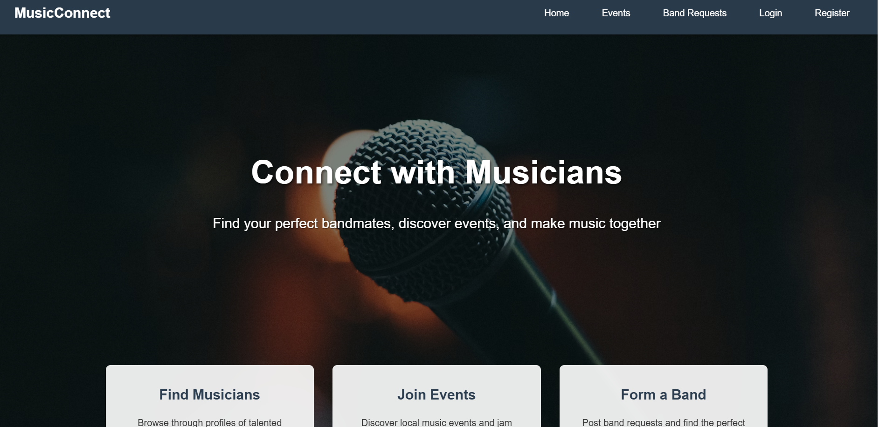
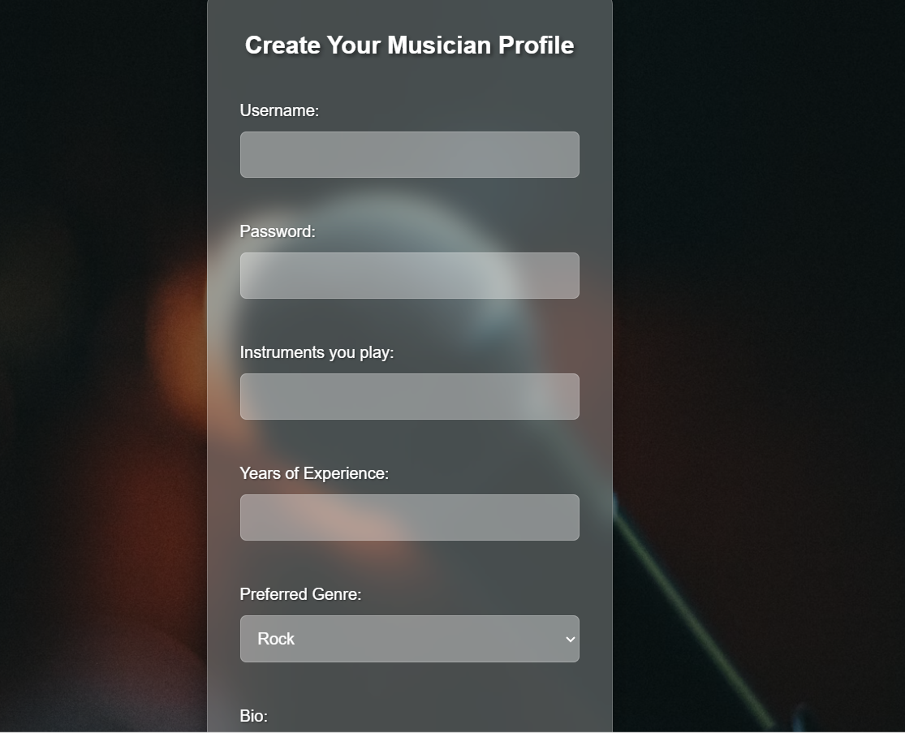
RESULT

Slide 11
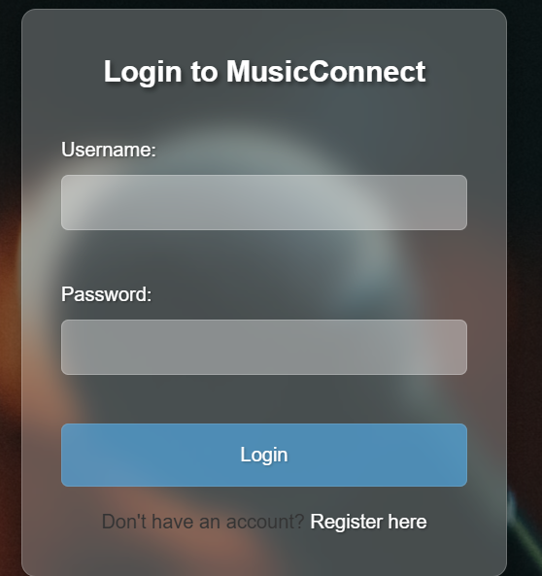
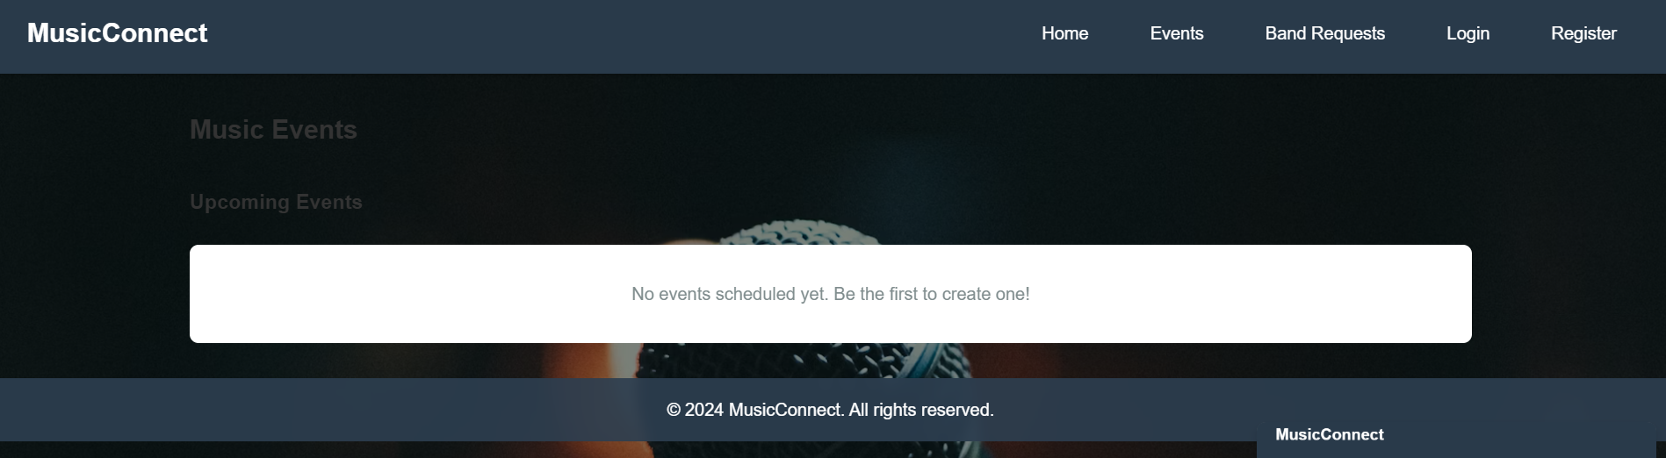

Slide 12
CONCLUSION
In this project we created a website that can be used by musicians to connect with each other to form a band
This website can also be used by event managers or organizers to contact a band that they like to perform in their show or event. This website can create a lot of opportunities for musicians. This website is created using HTML and Python. The website has a simple registration for the persons who are interested. The website also shows the upcoming shows
REFERENCES
Vampr:-https://www.vampr.me/
MusicianFinder:-https://musicianfinder.com/
Soundbetter:-https://soundbetter.com/

Slide 13
Thank You

